Slide 1


Slide 2
About the company
Green Destinations is a global organization created in the Netherlands to support sustainable destinations, their businesses and their communities.
Green Destinations’ core programs, the GD Awards and Certification Program for destinations, the Good Travel Program for businesses and the Top 100 Sustainability Stories are the main pillars of a country-wide stewardship approach that we have developed and piloted in Slovenia, Estonia, Australia, Brazil and Guyana.
Green Destinations developed a support program including over 40 assessment and reporting tools, including training courses.

Slide 3
Objective
The HR Director has recently noticed an increase in employees leaving (attrition). She would like to figure out any trends or patterns. She has surveyed the staff of Green Destinations and provided you with the data.
She would like to know what the attrition rate is (% of people who have left). She would also like to know if factors like age, years at the company and income play a part in determining if people will leave or not

Slide 4
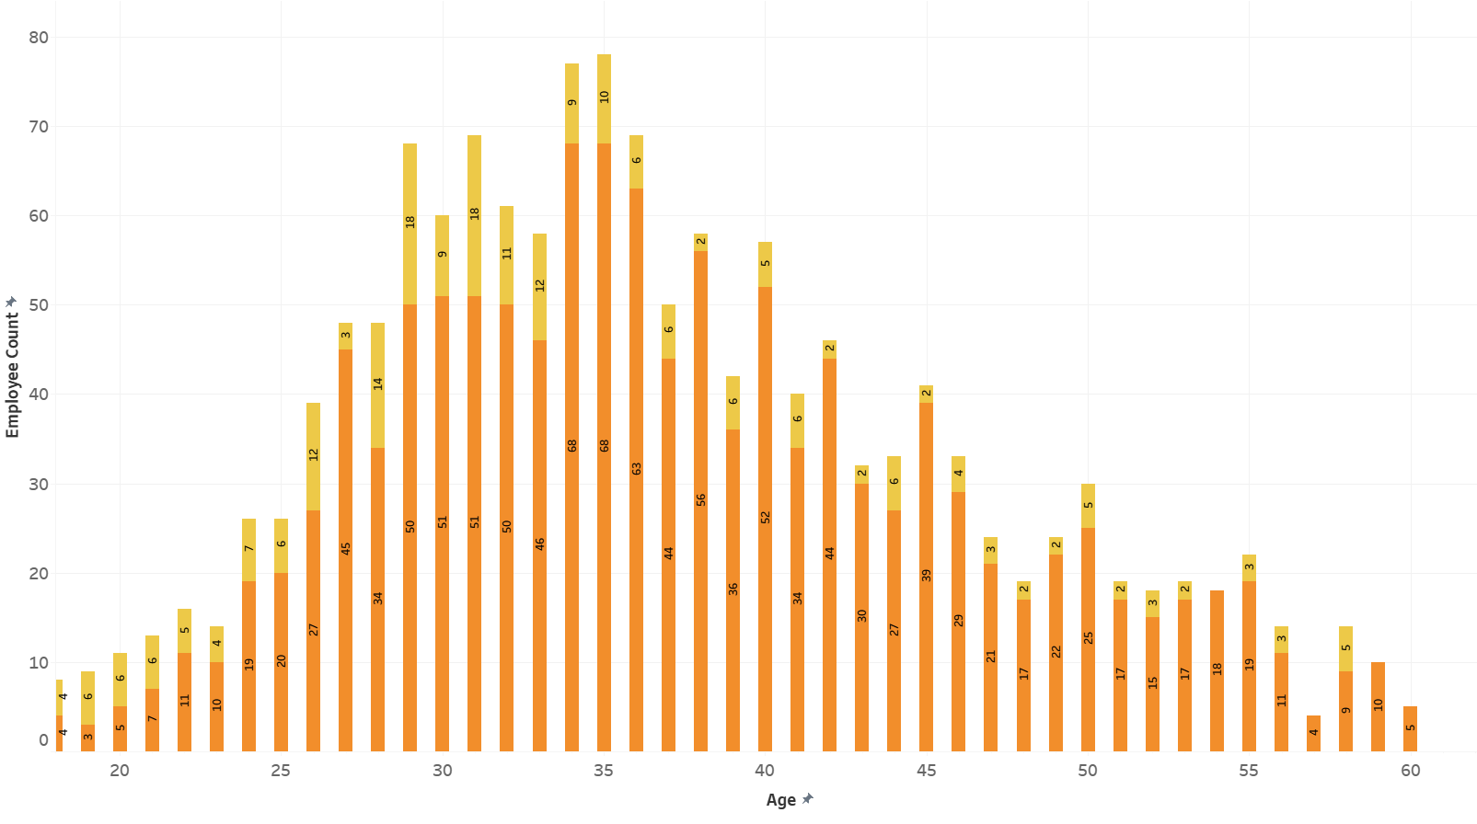
Distribution of Age by Attrition
There is a relatively higher proportion of younger employees among those who have left compared to those who have stayed.

Slide 5
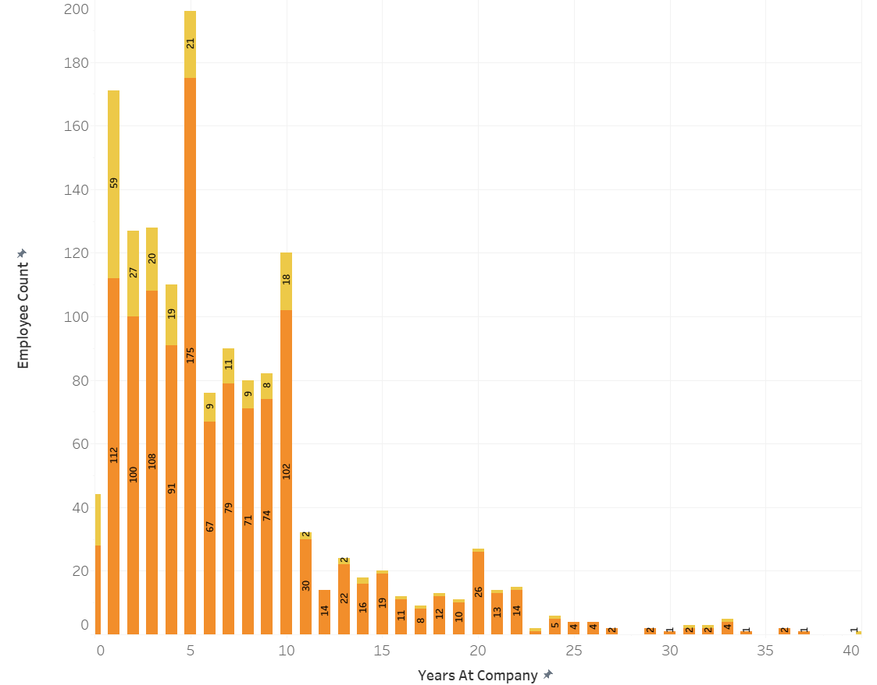
Distribution of Years at Company by Attrition
Employees with fewer years at the company seem to be more likely to leave, especially those with less than 5 years of tenure.

Slide 6
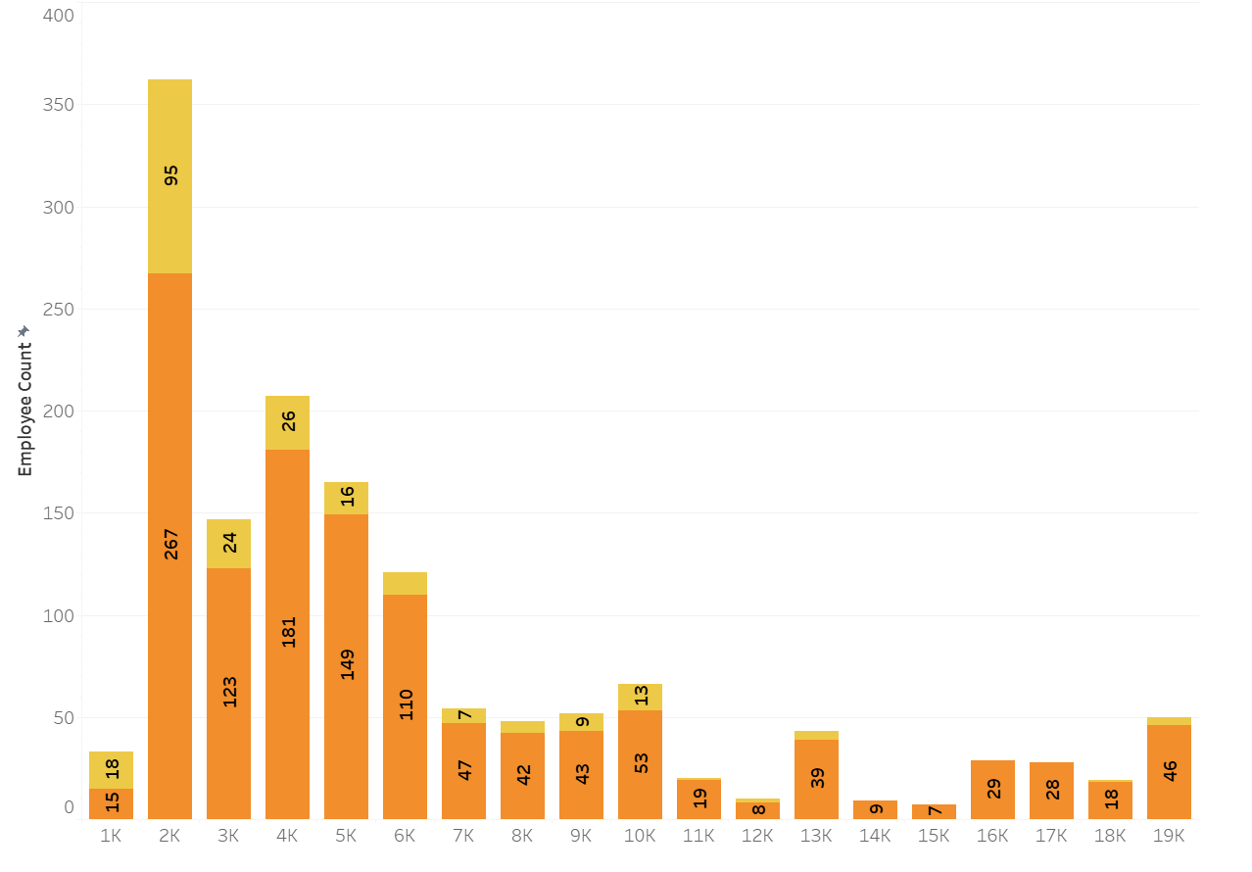
Distribution of Monthly Salary by Attrition
The distribution of monthly income is somewhat similar between employees who have left and those who have stayed.

Slide 7
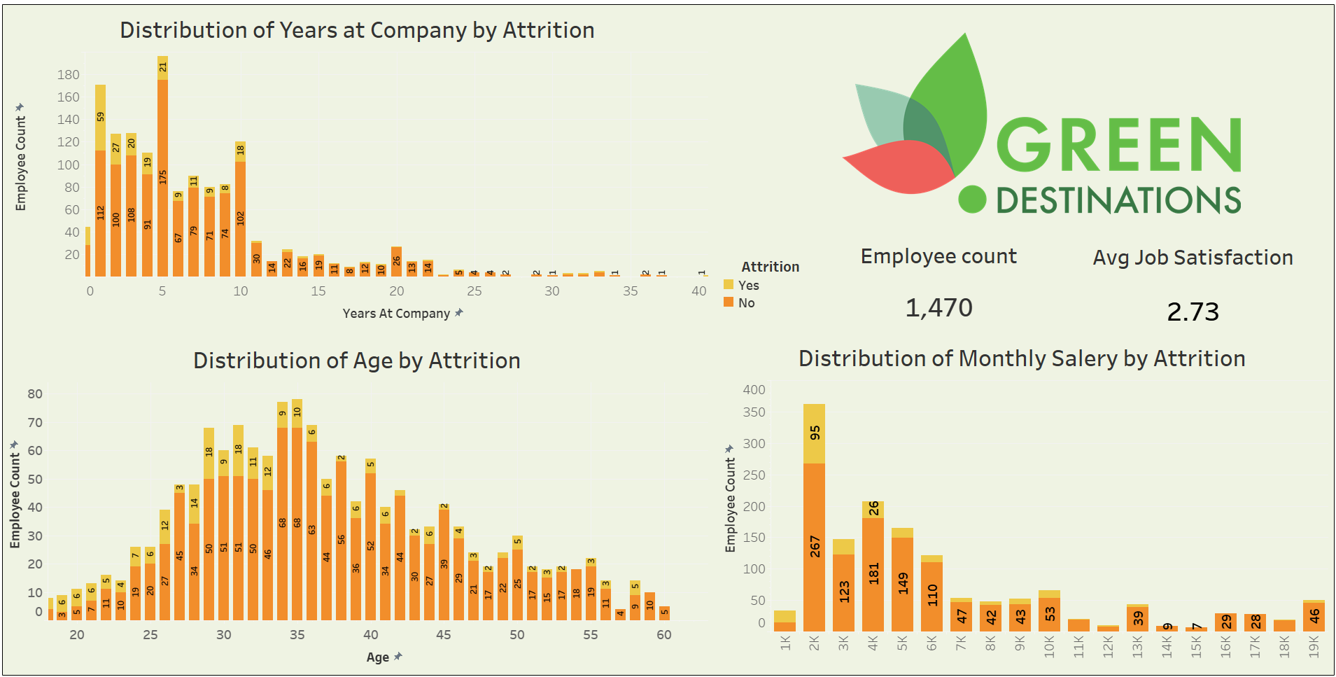
Dashboard

Slide 8
Thanks!
Do you have any questions?
gopimulaveesala81@gmail.com
+91 9573739351

